Slide 1

EchoMind: Intelligent Audio Transformation via Text Prompts
Presented By:
ABOUHANE Zahra, BAZGOUR Yassine
Supervised By:
Mohamed Amine Chadi
https://www.flaticon.com/search?word=data

Slide 2
Problematic
01

Slide 3
73%
of creators struggle with complex audio editing tools when trying to improve sound quality
(2024, Adobe Research)
https://blog.adobe.com/en/publish/2024/10/08/adobes-ai-creative-frontier-study-reveals-creators-views-opportunities-risks-generative-ai

Slide 4
OVER 70%
of audio editors believe AI-assisted tools still fail to accurately follow user instructions (2024, Audio Engineering Society)
https://menlovc.com/perspective/2025-the-state-of-consumer-ai/

Slide 5
8 IN 10
content creators say they waste hours manually editing audio instead of focusing on creativity (2024, Creative Workflow Survey)(2024, Adobe Research)
https://untechaihub.com/best-ai-tools-for-video-and-audio-content/

Slide 6
Aim
02

Slide 7

Intelligent Audio Editing through AI

Slide 8
System Architecture
03

Slide 9




Audio
Preprocessing
Model
Audio
Preprocessed
Audio
Raw
Audio
Edited
Audio
Editing
Prompt
User
Interface
Audio
Editing
Model
Result
Prompt
Embedded
Prompt
Text
Embeddings
Model

Slide 10
Data
04

Slide 11
Samples From The Dataset

Slide 12
7,023 images
4 diagnostic categories | 1 Normal | 3 Abnormal
Image Modality: T1-weighted contrast-enhanced MRI scans
High-resolution images
Class imbalance with abnormal as majority class
Labels confirmed by expert radiologists and pathologists to ensure diagnostic accuracy

Slide 13


Binary Skin Classifier Data
Multi Skin Classifier Data
Before: NUM Classes
Abnormal Classes: NUM Images
Normal Classes: NUM Images
After: NUM Classes
Abnormal Class: NUM Images
Normal Class: NUM Images
Before: NUM Classes
Abnormal Classes: NUM Images
Normal Classes: 8061 Images
After: NUM Classes
mel: NUM Images
bcc: NUM Images
akiec: NUM Images

Slide 14
Model
05

Slide 15
EfficientNetV2B0
India 2025
LINK
Accuracy: 96% | Recall: 100%
India 2024
LINK
Accuracy: 98% (ISIC) 99% (HAM)
Saudi Arabia 2022
Accuracy: 99% (Detection) Accuracy: 99% (Classification)
LINK

Slide 16
EfficientNetV2B0
Input Size: 224 × 224 × 3
Parameters: 7,184,897
Size: 7,184,897 (parameter) x 4 (byte) = 27.4 (Mb)
FLOPs: ~0.98B
Depth: 237 layers
Training Speed: Faster than EfficientNetV1 due to fused MBConv blocks

Slide 17
Interface
06

Slide 18




Technologies Used
HTML
Javascript
CSS
Python
Backend
Frontend

Slide 19
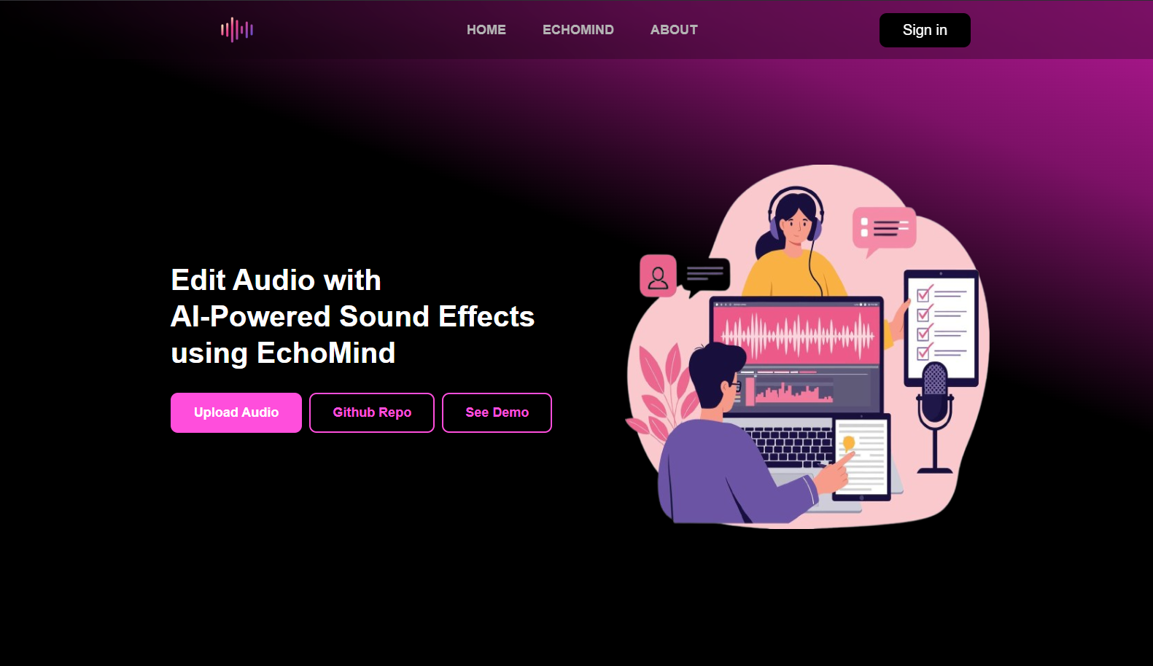

Slide 20
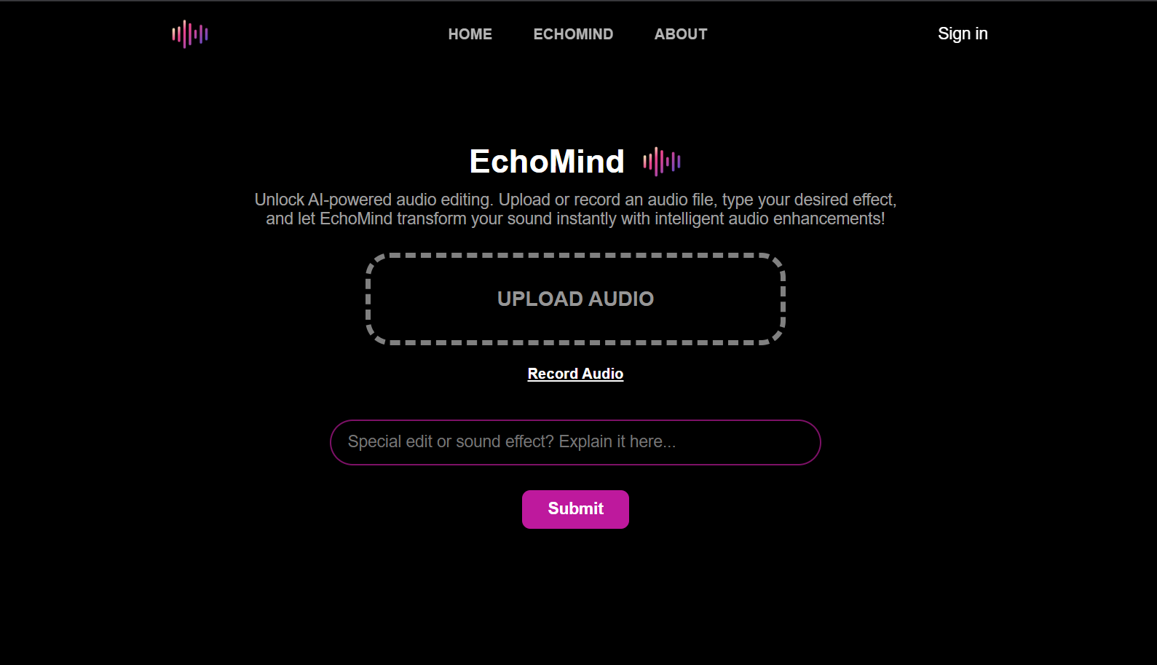

Slide 21
Results
07

Slide 22
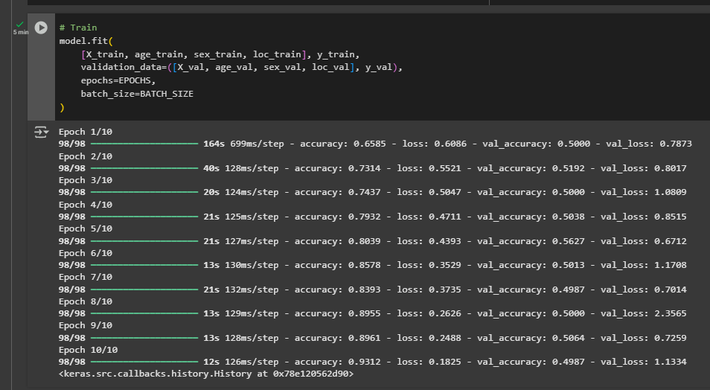

Slide 23
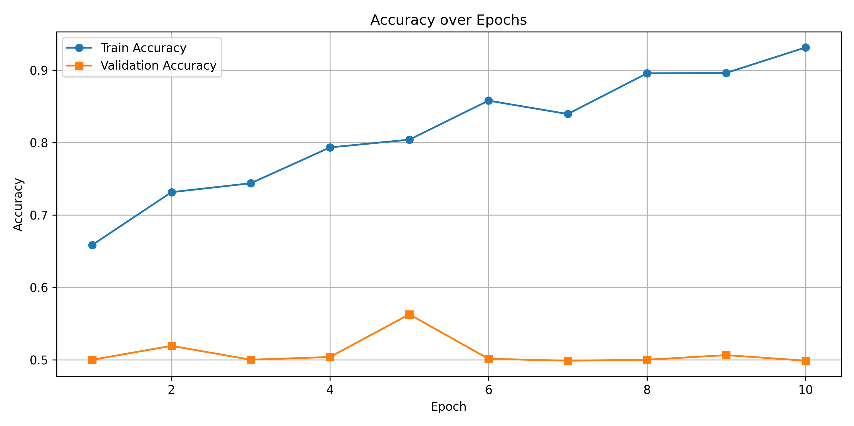

Slide 24
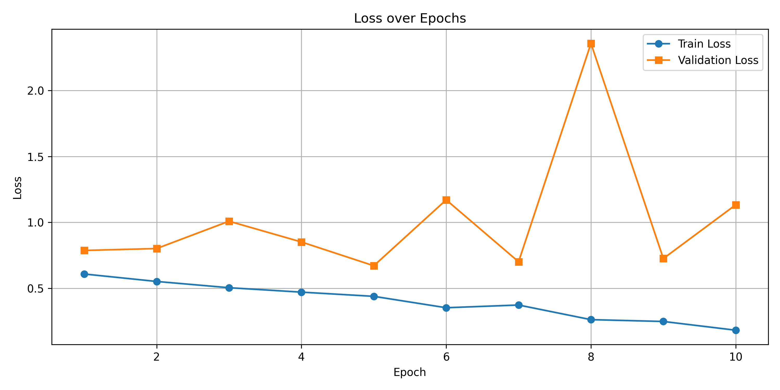

Slide 25
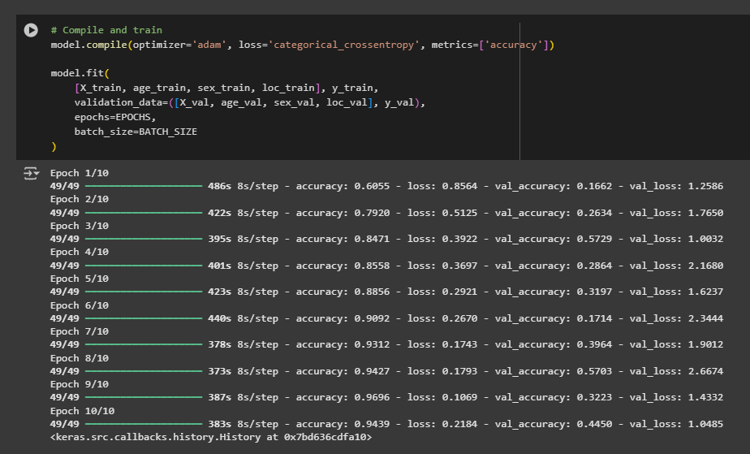

Slide 26
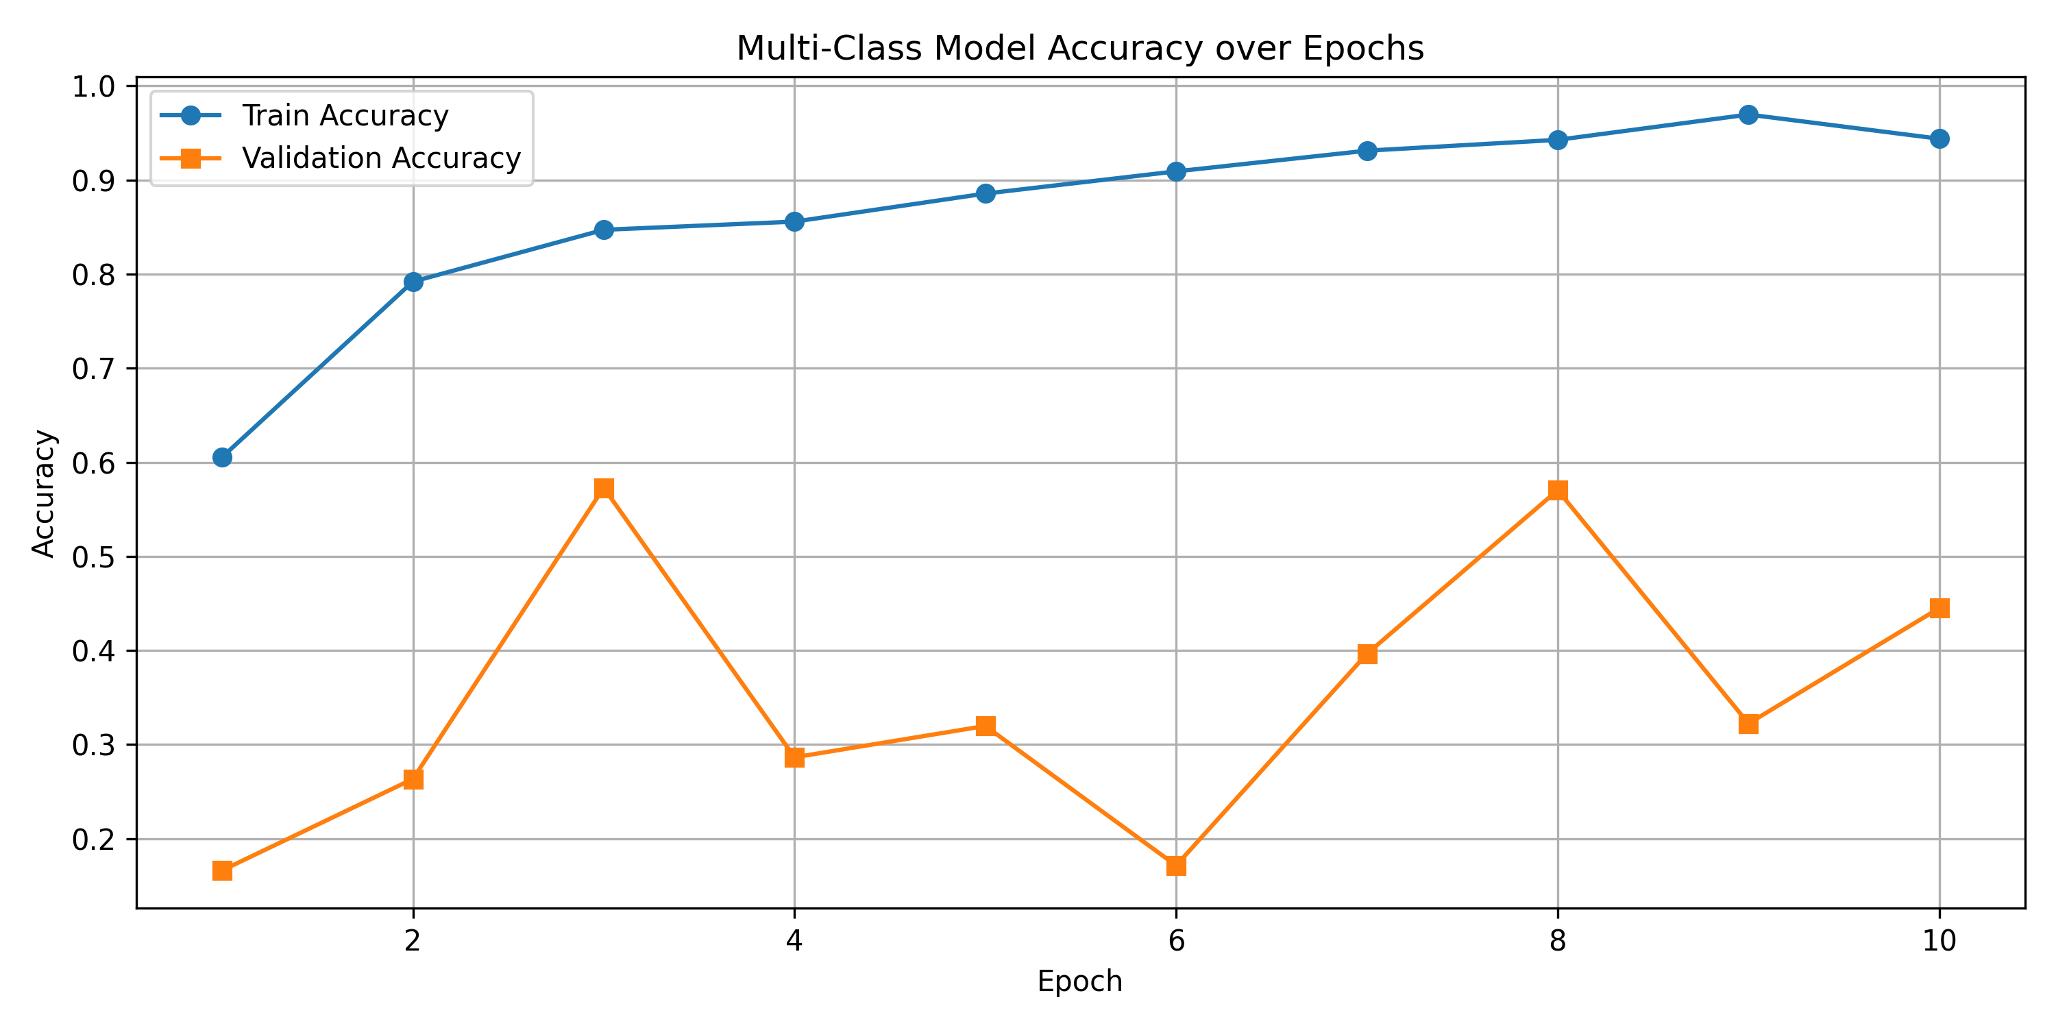

Slide 27
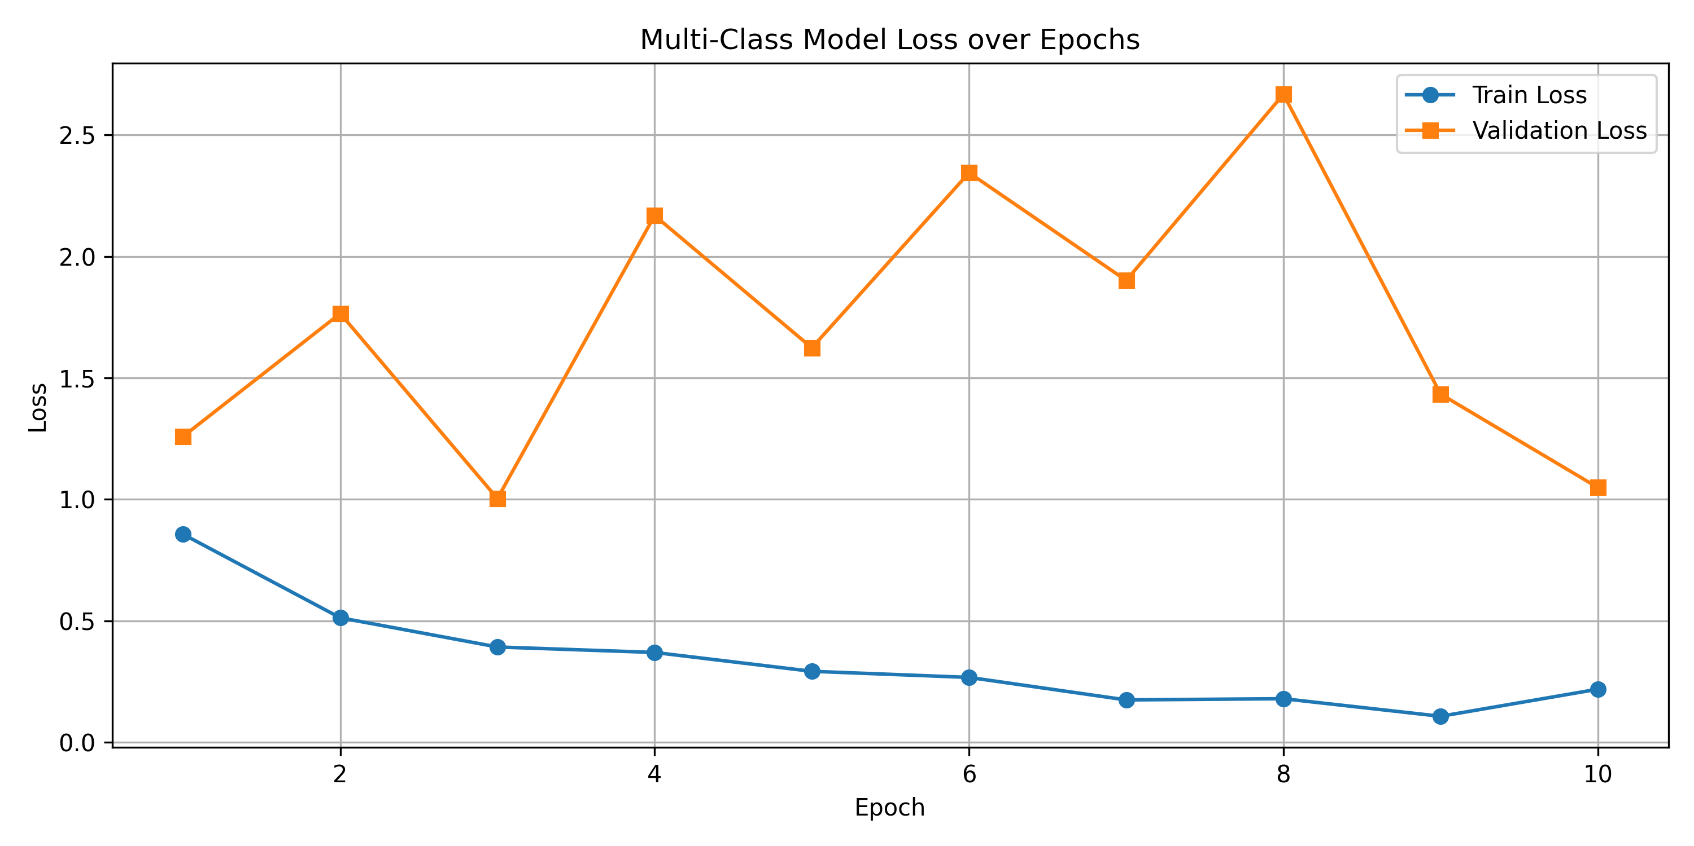

Slide 28
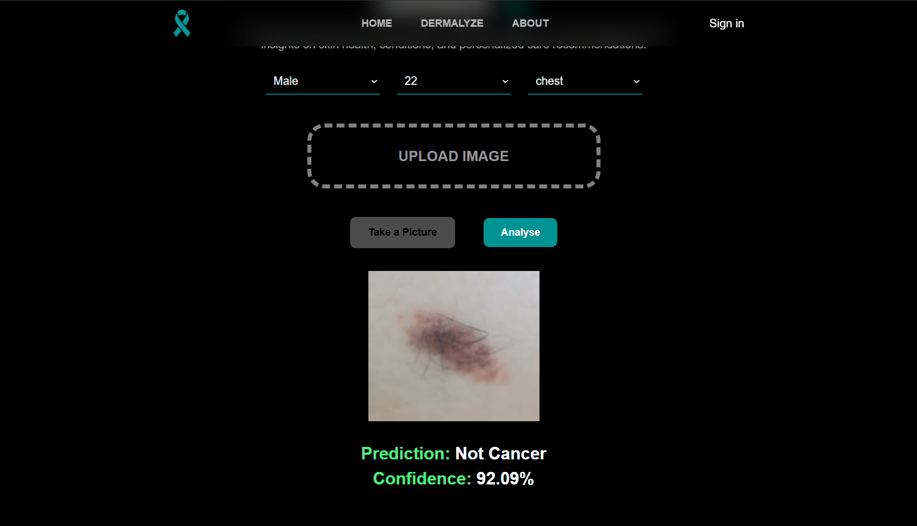

Slide 29
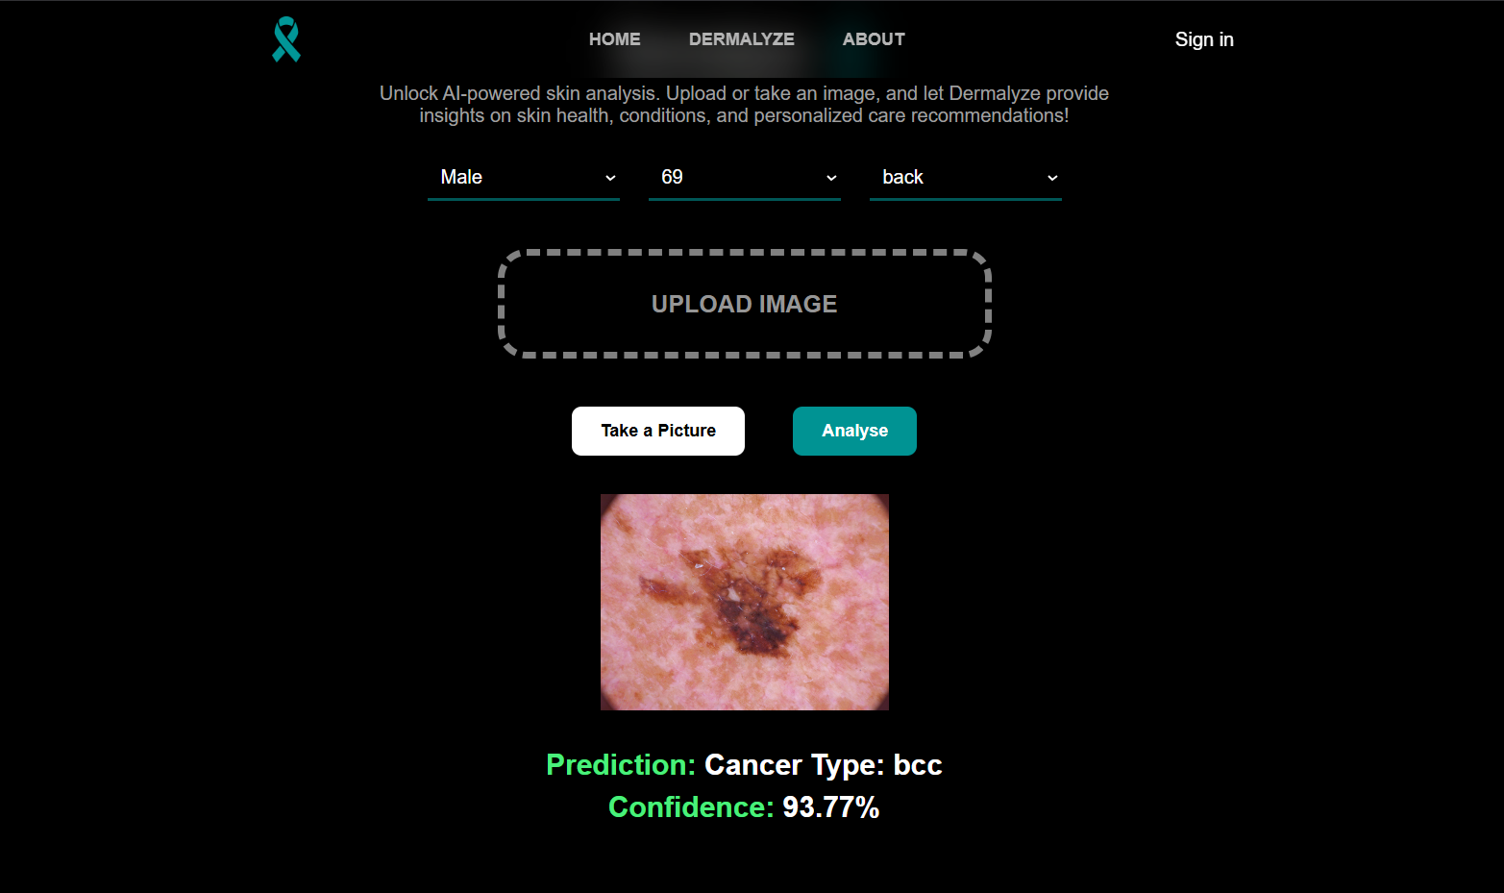

Slide 30
Demo
08

Slide 31
Discussion
09

Slide 32



Benefits
Content
Creation
Education and
Training
Media
Production

Slide 33


Limitations
Prompt understanding
Generalization
Limit

Slide 34
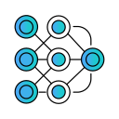

Future Work
Test Other Pretrained Models
Enlarge Dataset and Improve its Quality

Slide 35

Thank You

